Slide 1
Computer Fundamentals
Dr. Safdar Nawaz Khan Marwat
DCSE, UET Peshawar
Lecture 9
Notes:
Take Quiz 2

Slide 2
Memory
Stores open programs and data
Small chips on the motherboard
More memory makes a computer faster

Slide 3
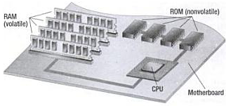
Memory (cont.)
Non-volatile memory
Holds data when power is off
Read Only Memory (ROM)
Basic Input Output System (BIOS)
Start-up instructions for turning on the system
Boot-up information
Power On Self Test (POST)
Ensuring that system functioning properly
Ensure presence of necessary hardware
Flash memory
Data is stored using physical switches
Special form of nonvolatile memory
Camera cards, USB key chains

Slide 4
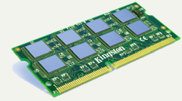
Memory (cont.)
Volatile memory
Requires power to hold data
Random Access Memory (RAM)
Data in RAM has an address
CPU reads data using the address
CPU can read any address

Slide 5
Memory (cont.)
SIMM
Single in-line memory module
Used from early 1980s to late 1990s
DIMM
Double in-line memory module
SO-DIMM
Small outline DIMM
Have small size
Designed for laptops

Slide 6
Memory (cont.)
SIMM vs. DIMM
DIMM has twice as many pins compared to SIMM
Although the number looks similar
Connectors on either side are connected to each other in SIMM
Electrical contacts redundant on both sides of module
SIMMs have 32-bit data path, while DIMMs have 64-bit data path

Slide 7
Memory (cont.)
DRAM
Dynamic RAM, often used as main memory
Stores each bit of data in a capacitor
Capacitor either charged or discharged
States represent two values of a bit,
Storage cell is dynamic
Needs to be recharged periodically to compensates for charge leaks
SRAM
Static RAM, often used as cache
Uses flip-flop circuitry to store each bit
Storage cell is static
Needs no periodic recharged
Still volatile, data lost when not powered
SDRAM
Synchronous DRAM
Kind of DRAM synchronized with clock speed of microprocessor
Operation of external pin interface coordinated by clock signal
Source: https://www.quora.com/What-is-the-difference-between-DRAM-SRAM-and-SDRAM-Which-one-is-the-best-RAM-technology
Notes:
Flip-flop or latch is a circuit that has two stable states and can be used to store state information

Slide 8
Memory (cont.)
SDR SDRAM
Single Data Rate SDRAM
Transfers data on rising edges of clock signal
Delivers single bit of data per signal line per clock cycle
DDR SDRAM
Double Data Rate SDRAM
Transfers data on both rising and falling edges of clock signal
Delivers two bits of data per signal line per clock cycle
QDR SDRAM
Quad Data Rate SDRAM
Transfers data on rising and falling edges, and two points in between
Delivers four bits of data per signal line per clock cycle
Source: https://en.wikipedia.org/wiki/Double_data_rate

Slide 9
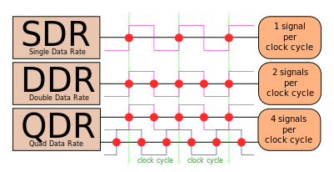
Memory (cont.)
Source: https://en.wikipedia.org/wiki/Double_data_rate

Slide 10
Components Affecting Speed
Registers
Number of bits processor can handle
Word size
Indicates amount of data computer can work on at a time
Larger indicates more powerful computer
Increase by purchasing new CPU

Slide 11
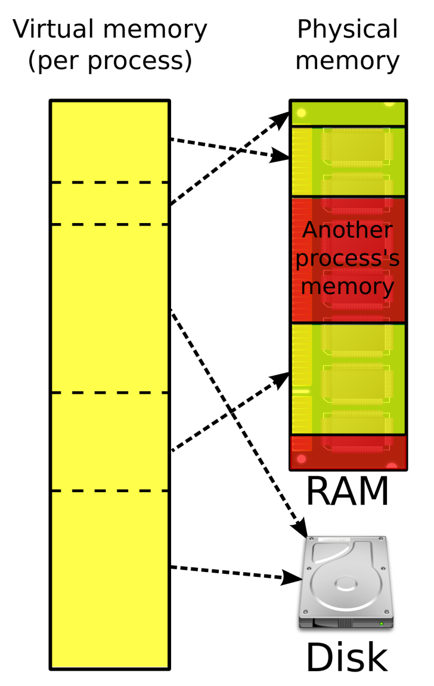
Components Affecting Speed (cont.)
Virtual RAM
Computer is out of actual RAM
Another drive used to emulate RAM
Computer swaps data to this virtual RAM
Least recently used data is moved
Source: https://en.wikipedia.org/wiki/Virtual_memory

Slide 12
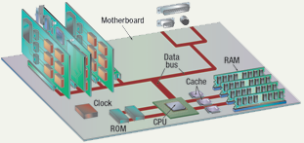
Components Affecting Speed (cont.)

Slide 13
Components Affecting Speed (cont.)
The computer’s internal clock
Quartz crystal
Molecule vibrate at a fixed rate when electricity provided
Frequency determined by thickness of crystal
Every tick causes a cycle
Time for turning transistor off and back on again
Speeds measured in Hertz (Hz)
Modern machines use Giga Hertz (GHz)
Each instruction require a given number of clock cycles

Slide 14
Components Affecting Speed (cont.)
The bus
Electronic pathway between components
Expansion bus connects to peripherals
System bus connects CPU and RAM
Data bus
Address bus
Bus width is measured in bits
Speed is tied to the clock

Slide 15

Components Affecting Speed (cont.)
System bus operation and sizes
Data bus connects CPU, memory and hardware
Address bus connect only CPU and memory
Carries memory addresses

Slide 16
Components Affecting Speed (cont.)
Bus standards
Industry Standard Architecture (ISA)
Local bus
Peripheral component interconnect (PCI)
Accelerated graphics port (AGP)
Universal serial bus (USB)
IEEE 1394 (FireWire)
PC Card

Slide 17
Components Affecting Speed (cont.)
Industry Standard Architecture (ISA) bus
16-bit data bus
Widely used in 80’s
Later on used for attaching slow devices
Modems
Input devices
Etc.
Local bus
Used to attach fast devices
Runs between components on motherboard

Slide 18
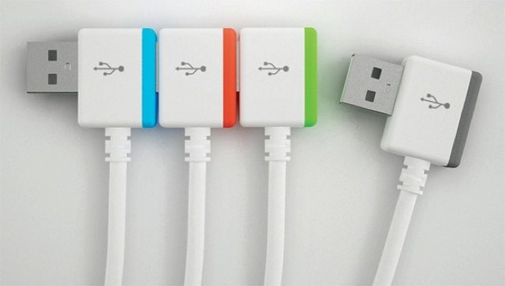
Components Affecting Speed (cont.)
Peripheral control interface (PCI) bus
Connects video and sound cards to motherboard
Card can not access system memory directly
Card can only access its own memory
Found in most modern computers
Accelerated Graphics Port (AGP) bus
Connects modern video cards to motherboard
Allows video card to access system memory directly
Extremely fast bus
3-D support
Universal Serial Bus (USB)
Connects external devices
Hot swappable
Allows up to 127 devices
Hub layout or daisy chain
For cameras, printers and scanners
Source: https://www.reddit.com/r/raspberry_pi/comments/4upogl/question_daisychaining_of_usb_for_up_to_10

Slide 19
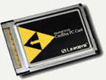
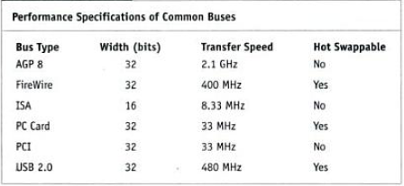
Components Affecting Speed (cont.)
IEEE 1394 (FireWire) bus
Connects cameras on Macintosh and IBM
PC Card bus
Used on laptops
Hot swappable
Devices are the size of a credit card
Expansion of memory

Slide 20
Components Affecting Speed (cont.)
Modern microprocessors process data in short time
However, quick access to data required
If data not available, processor has to wait
Results in reduced performance
Current processors process instruction in nanoseconds (ns)
Time for fetching data from main memory is about 100 ns
Solution???

Slide 21
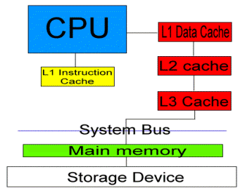
Components Affecting Speed (cont.)
Make main memory faster
1 ns memory extremely expensive
100 ns memory widely used
Add cache memory right next to microprocessor
Placed on the same chip
Frequently used data and instructions resides in cache
Also RAM type
Improves overall performance
Fast access to frequently-used data and instructions
Source: http://www.pantherproducts.co.uk/index.php?pageid=cpucache

Slide 22
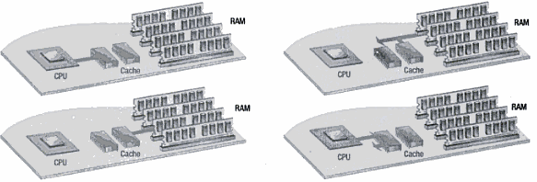
Components Affecting Speed (cont.)
Cache memory
Very fast memory
Holds common or recently used data
Speeds up computer processing
Moving data between CPU and RAM takes time as RAM is slow
CPU checks if data is in cache
Most computers have several caches
L1 holds recently used data
L2 holds potential upcoming instructions
L3 holds possible upcoming instructions

